Slide 1

Basic Details of the Team and Problem Statement
Ministry/Organization Name/Student Innovation:
National Technical Research Organisation,(NTRO)
PS Code:1456
Problem Statement Title:
Speech to text transcription for Indian languages. The problem entails transcription in the native script and then translation to English. The languages of interest are Hindi, Indian English, Urdu, Bengali, Punjabi. Team Name: The Grammer Gurus Team Leader Name: Abdul Shookur M Institute Code (AISHE): U-0725 Institute Name: Reva University
Theme Name: Miscellaneous

Slide 2

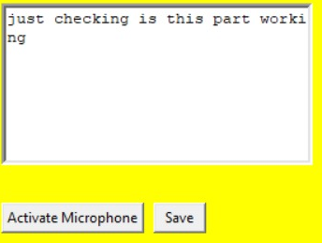
Idea/Approach Details
Module to recognize speech
Module to
Identify subject
Describe your idea/Solution/Prototype here:
Initial we will take regional language speech audio.
We train our BOT to identify the subject in it.
Using supervised Machine learning, we train our BOT find the meaning of it .
We will transcript the regional language speech to English.
Module to Transcript
Describe your Technology stack here:
Github
Stackover flow
Google collab
Virtual studio

Slide 3
Idea/Approach Details
Describe your Use Cases here
Describe your Dependencies / Show stopper here
oral content creator can transcript the content to one regional language to another language.
A person having knowledge of only one regional language, by using our software. he/she can read it out another regional language in there devices.
Subtitles can be generated in there own regional language in video.
tkintetr
pyttsx3
speech_recognition

Slide 4
Team Member Details
Team Leader Name: Abdul shookur M
Branch (Btech/Mtech/PhD etc): Btech Stream (ECE, CSE etc): ECE Year (I,II,III,IV): I
Team Member 1 Name: Shaik shahidh Siddique
Branch (Btech/Mtech/PhD etc): Btech Stream (ECE, CSE etc): ECE Year (I,II,III,IV): I
Team Member 2 Name: Shreyas Krishna G
Branch (Btech/Mtech/PhD etc): Btech Stream (ECE, CSE etc): ECE Year (I,II,III,IV): I
Team Member 3 Name: Vivek M A
Branch (Btech/Mtech/PhD etc): Btech Stream (ECE, CSE etc): ECE Year (I,II,III,IV): I
Team Member 4 Name: Mahesh M
Branch (Btech/Mtech/PhD etc): Btech Stream (ECE, CSE etc): ECE Year (I,II,III,IV): I
Team Member 5 Name: Prerita P
Branch (Btech/Mtech/PhD etc): Btech Stream (ECE, CSE etc): ECE Year (I,II,III,IV): I
Team Mentor 1 Name: Dr. Chaya R
Category (Academic/Industry): Academic Expertise (AI/ML/Blockchain etc): Machine learning Domain Experience (in years): 10 years

